Slide 1
Prayer

Slide 2
Wanting more from prayer . . .
Luke 11:1
“Lord, teach us to pray, just as John taught his disciples.”

Slide 3
Exemplar prayers
Luke 18:9-14
Pharisee vs Tax collector
1 Kings 8:22-61
Solomon’s prayer of dedication
Daniel 9:4-19
Daniel’s intercessory prayer

Slide 4
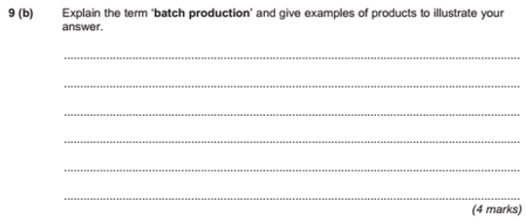
Exam questions

Slide 5
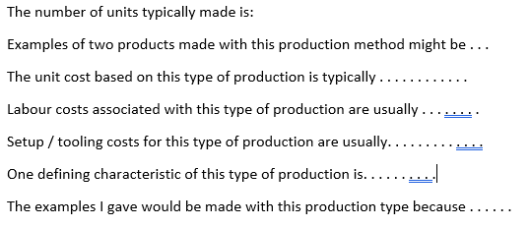
Writing frame

Slide 6
The lord’s prayer – a writing frame
Our Father in heaven, may your name be kept holy.
May your Kingdom come soon.
May your will be done on earth, as it is in heaven.
Give us today the food we need, and forgive us our sins as we have forgiven those who sin against us.
And don’t let us yield to temptation, but rescue us from the evil one.
For yours is the kingdom and the power and the glory forever. Amen.

Slide 7
Using the Writing frame
Our Father in heaven, may your name be kept holy.
May your Kingdom come soon.

Slide 8
Using the Writing frame
May your will be done on earth, as it is in heaven.

Slide 9
Using the Writing frame
Give us today the food we need,

Slide 10
Using the Writing frame
and forgive us our sins as we have forgiven those who sin against us.

Slide 11
Using the Writing frame
And don’t let us yield to temptation, but rescue us from the evil one.

Slide 12
Using the Writing frame
For yours is the kingdom and the power and the glory forever. Amen.

Slide 13
Analysing communication

Slide 14
Analysing communication
Young couple
Mature couple

Slide 15
Analysing our prayers
‘The Lord’s Prayer’ ?
Our prayers?

Slide 16
Conclusions
“Lord teach us to pray . . .”
Do our prayers need to become:
more about relationship (80%)
Less about ‘functional’ (20%)

Slide 17
When god says yes. . .
When God says ‘no’
Four ways God says ‘yes’

Slide 18
1 - Miracles
When God alters reality to answer us
It does happen
We call it a ‘miracle’
Not a ‘normal’
The exception rather than the rule.

Slide 19
2 - answers
Speaks directly to us
Speaks to us through His Word – the Bible
Speaks to us through church (others)
Speaks to us through the sermon

Slide 20
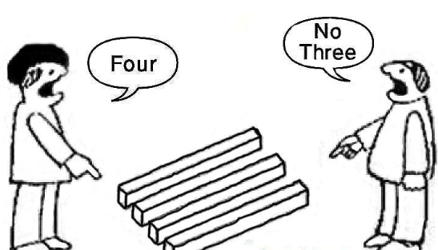
3 - perception
Same problem different response / feelings / ways of coping.
“And we know that all things work together for good to them that love God, to them who are called according to his purpose.”
Romans 8:28
Therapy?

Slide 21
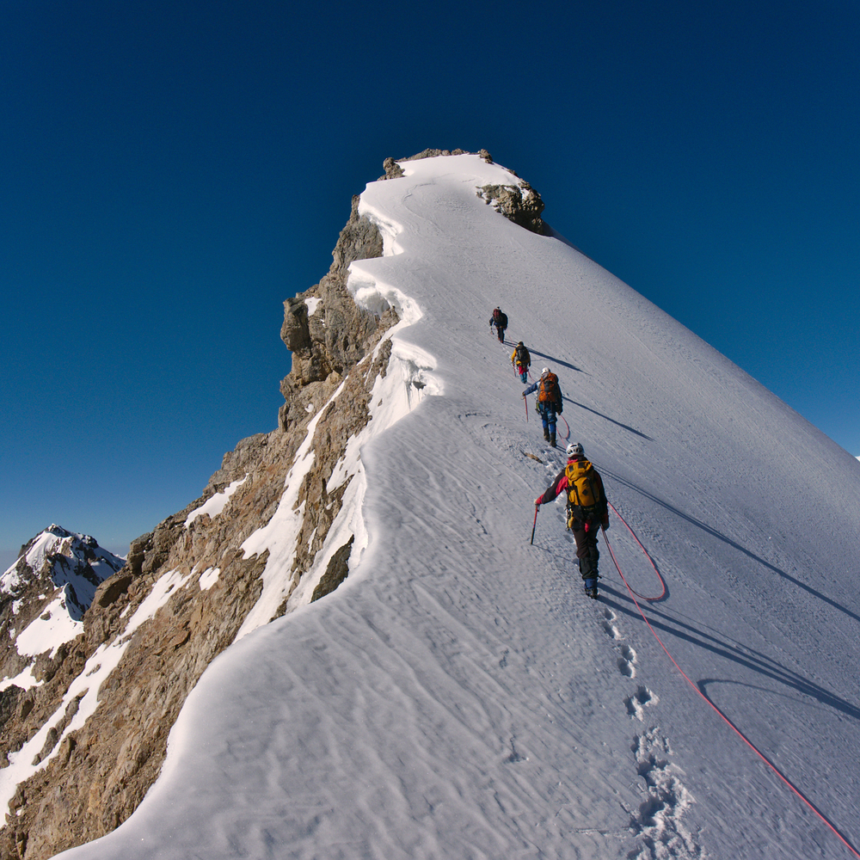
4 - capacity
Challenge
Growth
Application

Slide 22
warning
God has 4 (or more) ways of answering.
Beware limiting God’s options by asking ‘closed’ questions.

Slide 23
Summary
If we want more from our prayers (Lord teach us to pray. . . )
Apply the 80/20 rule – build relationship
‘Position’ ourselves relative to God’s will and kingdom
Use the Lord’s prayer as a structure
Look for God’s answers – whatever the format!

