Slide 1
We’re separate because...
How we manage our money – Part 2

Slide 2

5 Financial Commandments - Recap
5 - Financial Commandments
Live on a Budget
Save for rainy days
Save for Life events
.
.

Slide 3
5 Financial Commandments
5 - Financial Commandments
Live on a Budget
Save for rainy days
Save for Life events
Get out of debt
.

Slide 4
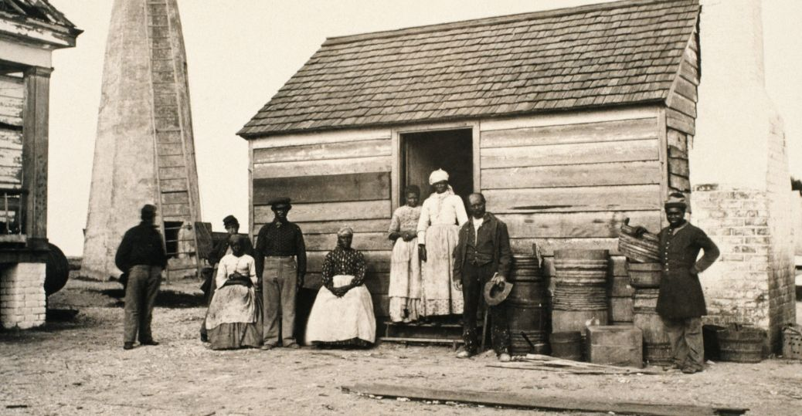
Debt & Slavery
The rich rule over the poor,
and the borrower is slave to the lender.
(Proverbs 22:7)
Define slave?

Slide 5
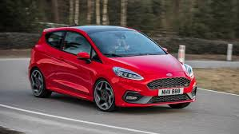
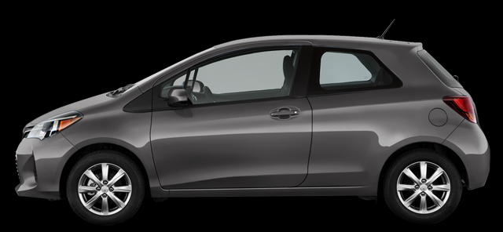
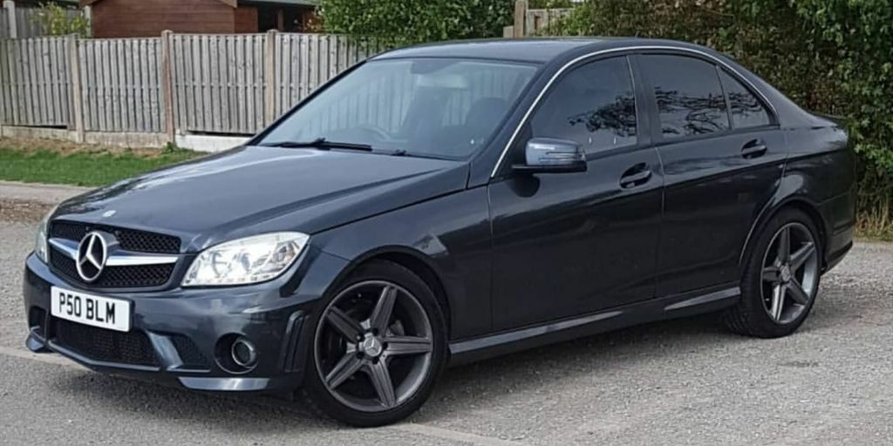
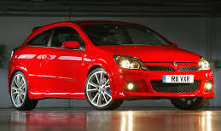
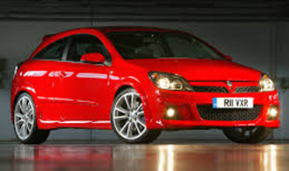
Slaves? A true tale. . .
£3500
£250 / month
£12,500
£16000
£0.00
£2000
£250 / month
£11,000
£10,000 +
3 Years
4 Years

Slide 6
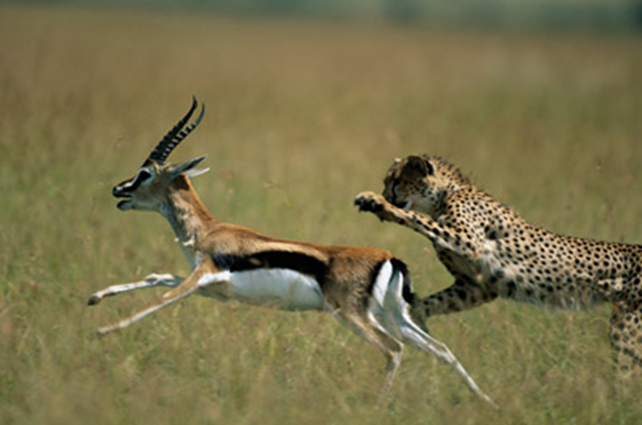
God’s view of debt. . .
Let no debt remain outstanding, except the continuing debt to love one another,
(Romans 13:8)
My son . . . if you have shaken hands in pledge for a stranger, . .
Free yourself, like a gazelle from the hand of the hunter,
like a bird from the snare of the fowler.
(Proverbs 6:1 & 5)

Slide 7
How to – snowball. . . Stage 1
Capital
Interest

Slide 8
How to – snowball. . .Stage 2
Capital
Interest

Slide 9
How to – snowball. . . Stage 3
Capital
Interest

Slide 10
How to – snowball. . . Stage 4
Capital
Interest

Slide 11
Mortgages not included . . .

Slide 12
5 Financial Commandments
5 - Financial Commandments
Live on a Budget
Save for rainy days
Save for Life events
Get out of debt
.

Slide 13
5 Financial Commandments
5 - Financial Commandments
Live on a Budget
Save for rainy days
Get out of debt
Save for life events
Invest for the future
Correct Sequence

Slide 14

Investing
Options
1) Invest in stock market, bonds, property etc.
Never invest more than I can afford to lose!

Slide 15
Investing
Options
2) Invest in mortgage
Arrangement fees (~£13,000 = £22000) Total repayment ~£190,000

Slide 16
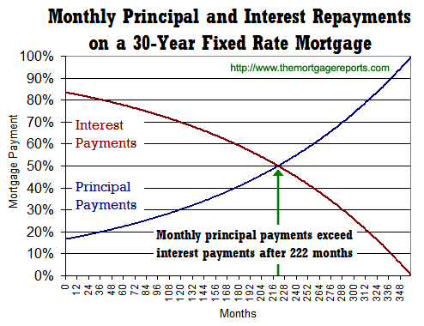
Maximising impact:

Slide 17
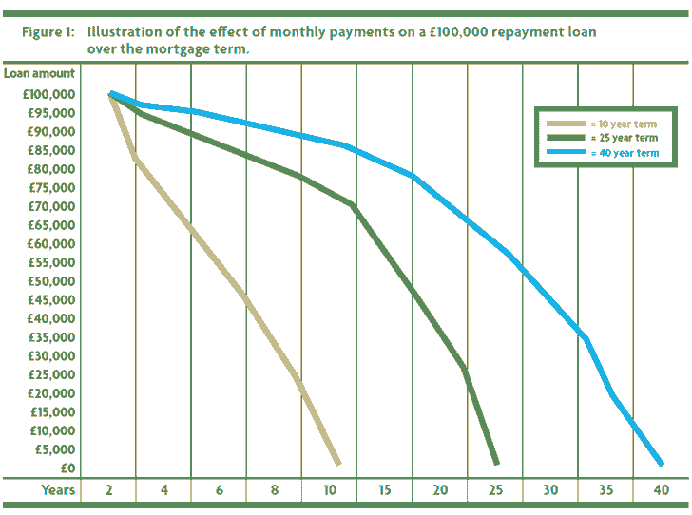
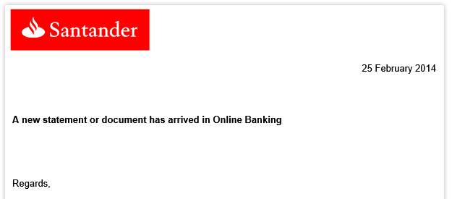
Emotional Learning. . .

Slide 18
Investing
Options
3) Invest in the kingdom of heaven
I tell you, use worldly wealth to gain friends for yourselves, so that when it is gone, you will be welcomed into eternal dwellings.
(Luke 16:9)
But store up for yourselves treasures in heaven, where moths and vermin do not destroy, and where thieves do not break in and steal.
(Matthew 6:20)

Slide 19
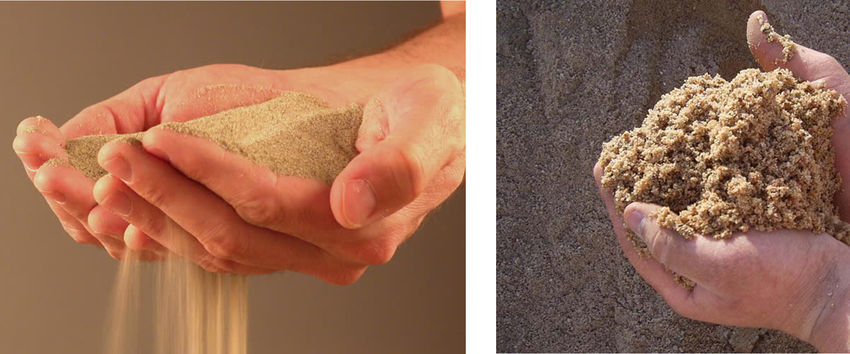




Recap 5 Commandments:
Live on a Budget
Save for a rainy day
Get out of debt
Save for the long term
Invest

Slide 20
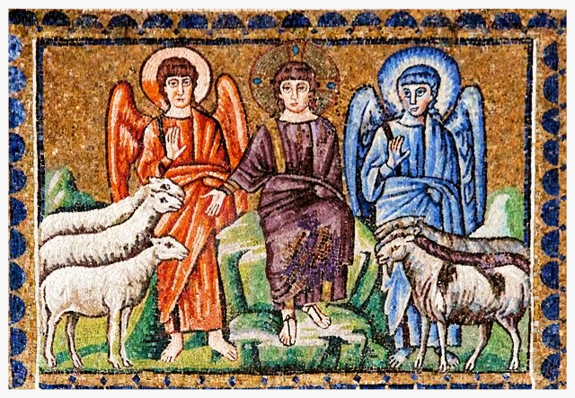
Summing it all up
Matthew 25

Slide 21
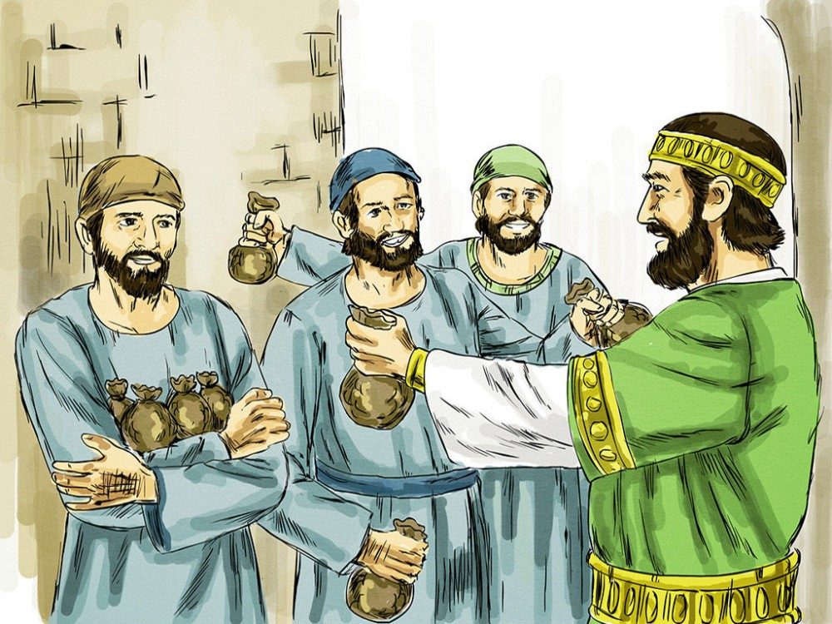
Summing it all up
Matthew 25

Slide 22
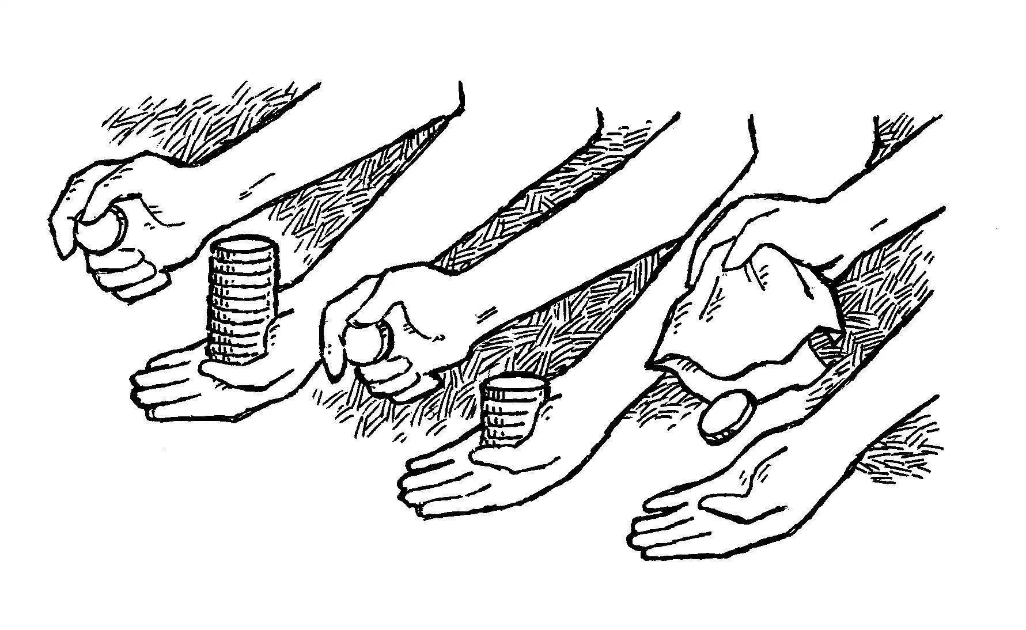
Summing it all up
Matthew 25 & Luke 19

Slide 23
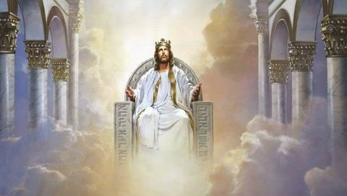
Summing it all up
Matthew 25 & Luke 19

