Slide 1
We’re separate because...
How we manage our money!

Slide 2

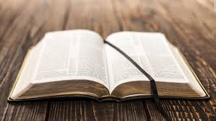
Truth or Example
Wealthy Experts

Slide 3
Typical Church Teaching. . .
Texts the church
teaches on
Other texts about
money in the Bible
2500 scriptures

Slide 4


Rationale for message:

Slide 5

Learning to think differently

Slide 6
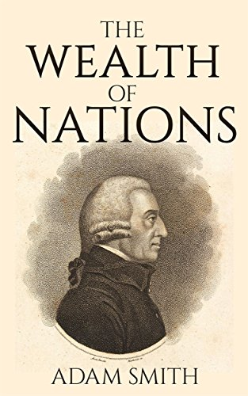
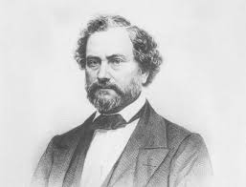
Samuel Colt

Slide 7

5 Financial Commandments
5 - Financial Commandments
.
.
.
.
.

Slide 8
5 Financial Commandments
5 - Financial Commandments
Live on a Budget
.
.
.
.

Slide 9
Financial Commandment – 1
²⁸ “Suppose one of you wants to build a tower. Won’t you first sit down and estimate the cost to see if you have enough money to complete it? ²⁹ For if you lay the foundation and are not able to finish it, everyone who sees it will ridicule you, ³⁰ saying, ‘This person began to build and wasn’t able to finish.’ (Luke 14:28)
The plans of the diligent lead to profit as surely as haste leads to poverty. (Proverbs 21:5)
Be sure you know the condition of your flocks, give careful attention to your herds; (Proverbs 27:23)
Put your outdoor work in order and get your fields ready; after that, build your house. (Proverbs 24:27)

Slide 10
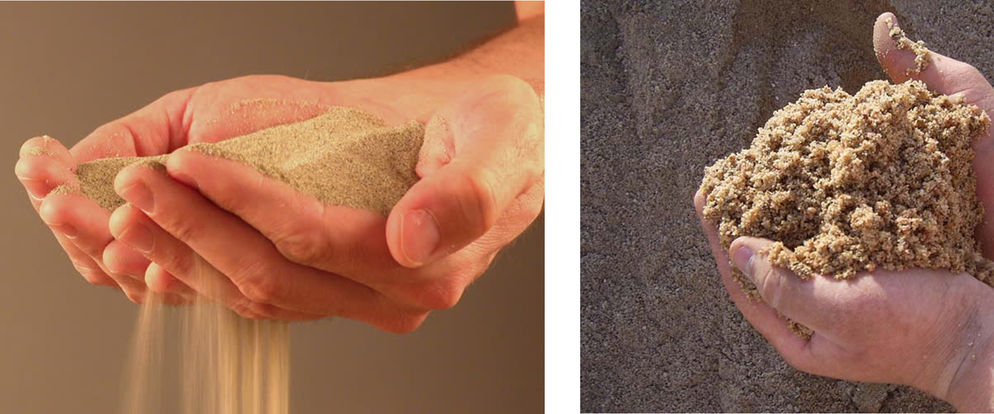
Advantages of Living on a Budget
Save yourself money

Slide 11
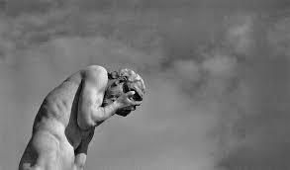
Advantages of Living on a Budget
2. Freedom to spend without feeling guilty

Slide 12
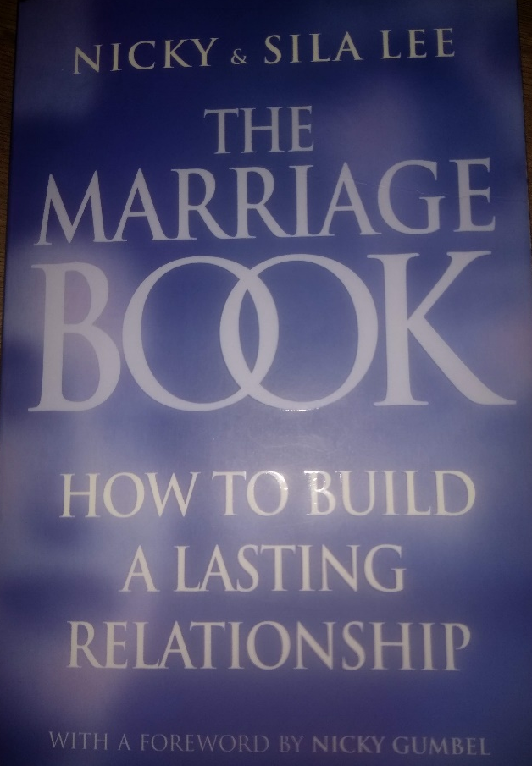
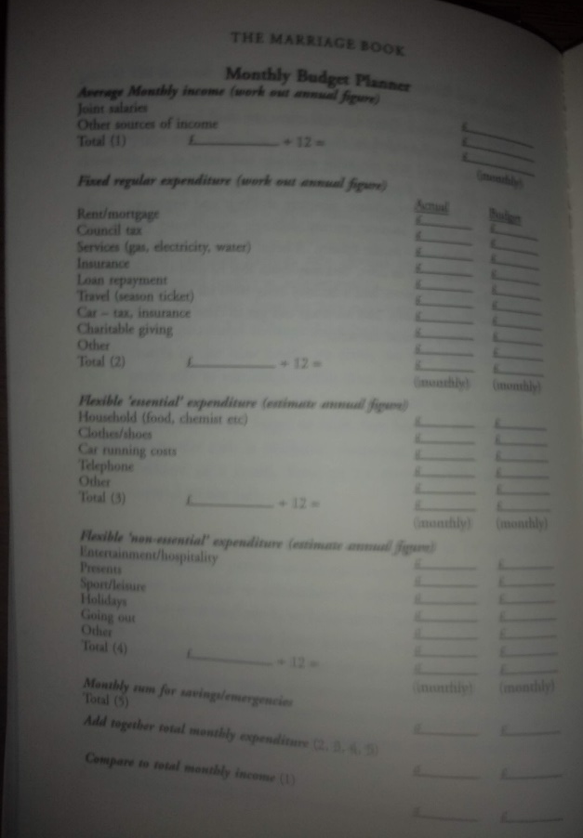
Advantages of Living on a Budget
3. Avoid arguments and divorce

Slide 13
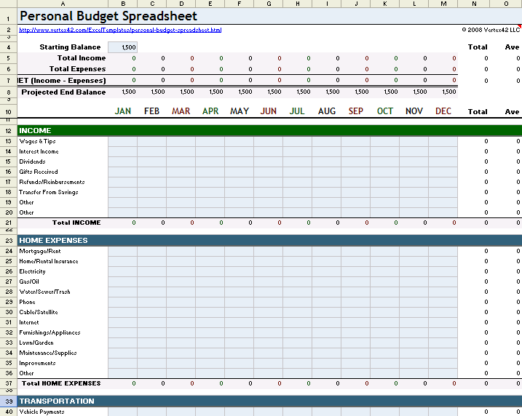
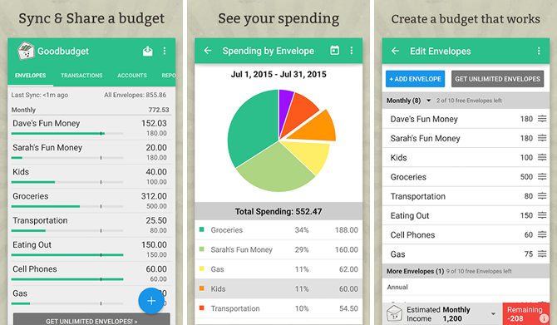
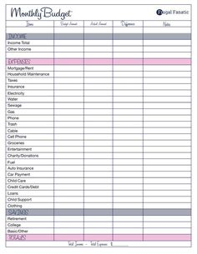
Budget how-to. . .

Slide 14


Budget how-to. . .

Slide 15
5 Financial Commandments
5 - Financial Commandments
Live on a Budget
.
.
.
.

Slide 16
5 Financial Commandments
5 - Financial Commandments
Live on a Budget
Save for rainy days
.
.
.

Slide 17
Save for a Rainy Day
Wise people store up the best food and olive oil.
But foolish people eat up everything they have.
(Proverbs 21:20)
>80%

Slide 18

Save for a Rainy Day
Save £500 - £1000
Sell stuff!
Set aside £50 a month (minimum)

Slide 19
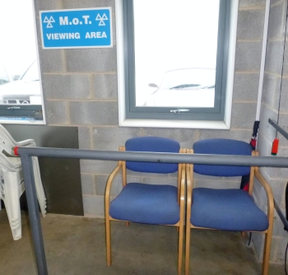
Emotional Learning
How does it feel?

Slide 20
5 Financial Commandments
5 - Financial Commandments
Live on a Budget
Save for rainy days
.
.
.

Slide 21
5 Financial Commandments
5 - Financial Commandments
Live on a Budget
Save for rainy days
Save for Life events
.
.

Slide 22
Save for Life Events – Long term
Wise people store up the best food and olive oil.
But foolish people eat up everything they have.
(Proverbs 21:20)

Slide 23
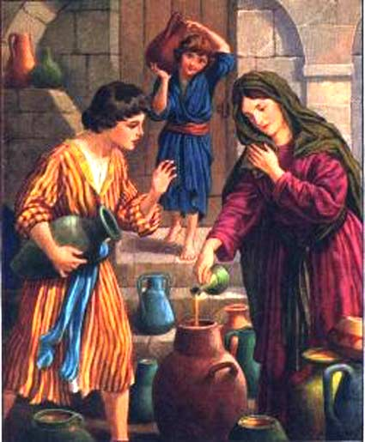
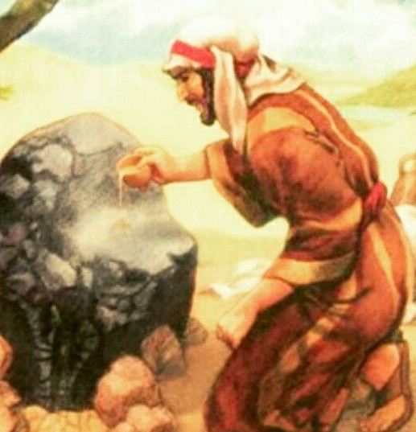
Storing up ‘oil’
2 Kings 4
Nutrition
Light
Cosmetics
Storing Value

Slide 24
The Scandinavian Solution
“There’s no such thing as bad weather – just the wrong clothing”
There’s no such thing as a financial disaster – just a lack of saving for the inevitable rainy day.
Save 3-6 month’s wages
Save for retirement
Save for once-in-a-lifetime trip
Save for our children’s start in life

Slide 25
How to?
Dishonest money dwindles away, but whoever gathers money little by little makes it grow. (Proverbs 13:11)
Save bit by bit – from the start
Make saving a part of Living on a budget (Commandment 1)

Slide 26
5 Financial Commandments
5 - Financial Commandments
Live on a Budget
Save for rainy days
Save for Life events
.
.

Slide 27

Wrapping it up. . .
ACTION
TRUST
Notes:
Story of Mike and mortgage/rent. Just trusting God? Hoping Jesus will return before retirement etc.

Slide 28
Wrapping it up. . .
Claiming to ‘trust’ God
Trusting God’s advice
Notes:
Story of friend and mortgage/rent. Just trusting God? Hoping Jesus will return before retirement etc.

