Slide 1
We’re separate because...
We believe the Bible is Inspired!

Slide 2
2 Timothy 3:16
“Every scripture is inspired by God and useful for teaching, for reproof, for correction, and for training in righteousness,”

Slide 3
Verbal Inspiration:
the theological doctrine that a divine inspiration extends to every word of a particular text
God breathed. . .
Theos / Pneuma

Slide 4
Most dispute around this term:
Plenary, Verbal inspiration
Orthodoxy. . .
VS
Heresy!

Slide 5
Is this correct?
Reasons I don’t accept ‘Verbal Inspiration’

Slide 6
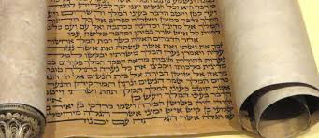
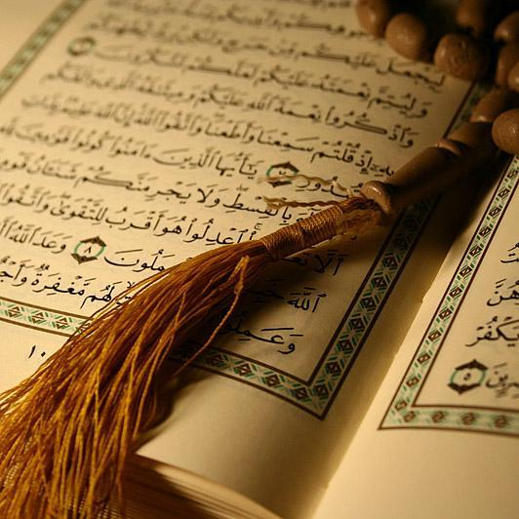
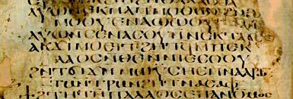
1: We are not reading the ‘words’ of God:

Slide 7
2: Because of textual variants
What is a ‘textual variant’?
A change in spelling
A word change
An omission
A ‘scribal addition’
Later additional text
The scale of the problem?
Greek New Testament contains around 138,000 words
All documents considered provide 500,000 textual variants!

Slide 8
2: Because of textual variants
Examples:
Mark 9:29 ²⁹ He told them, “This kind can come out only by prayer.” (and fasting)
Mark 16:1-8 (original ending of the Gospel)
Mark 16:9-20 (later, uncredited ending)
John 7:53 – 8:11 (Not originally part of John’s gospel)

Slide 9
3: Because Paul wrote a paradox:
1 Corinthians 7
¹⁰ To the married I give this command—not I, but the Lord—a wife should not divorce a husband. . .
¹² To the rest I say—I, not the Lord—if a brother has a wife who is not a believer. . .
Was Paul ‘verbally inspired’ when he stated what followed was not God’s words?

Slide 10
Conclusion: EGW quote
“It is not the words of the Bible that are inspired, but the men that were inspired. Inspiration acts not on the man’s words or his expressions but on the man himself, who, under the influence of the Holy Ghost, is imbued with thoughts. But the words receive the impress of the individual mind. The divine mind is diffused. The divine mind and will is combined with the human mind and will; thus the utterances of the man are the word of God”
(Selected Messages, vol. 1, 21).

Slide 11
In simple terms:
God inspires:
Motivates
Enables
Empowers
Preserves.

Slide 12
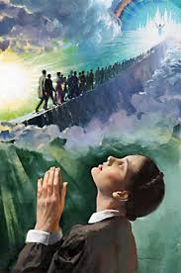
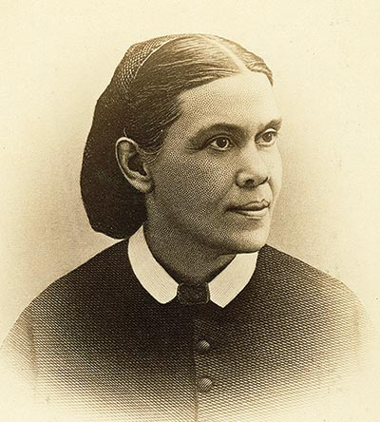
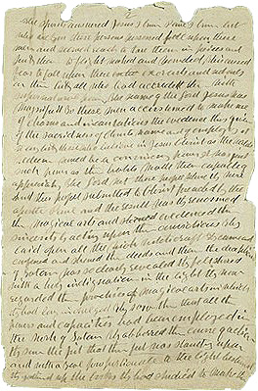
SDA relationship with Inspiration:

Slide 13
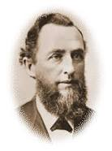
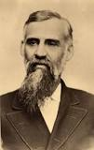
SDA relationship with Inspiration:
Uriah Smith
George I Butler
1880s
5 ‘Levels’ of inspiration

Slide 14
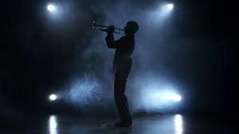
Mono-phonic view:

Slide 15
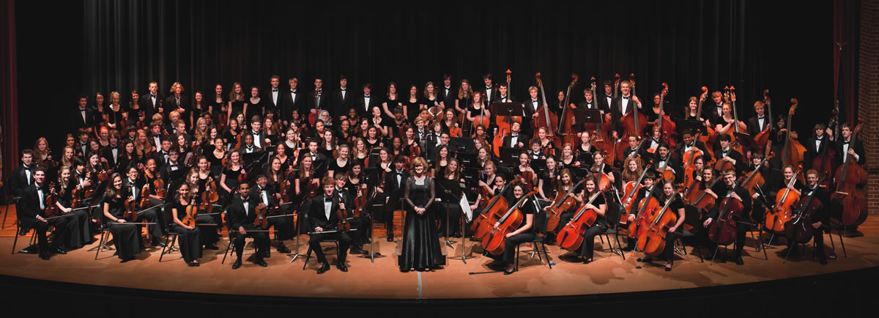
Symphonic view:

Slide 16
Conclusion: Scripture is complex
‘Plenary Verbal Inspiration’ is too narrow a term
A ‘Symphonic’ view of inspiration allows for:
The words of God
Visions from God
The words (experiences) of men
An inspired account of history
Poetry, wisdom
Sometimes singly, sometimes in harmony.

Slide 17
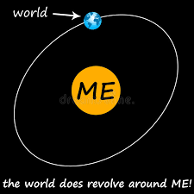
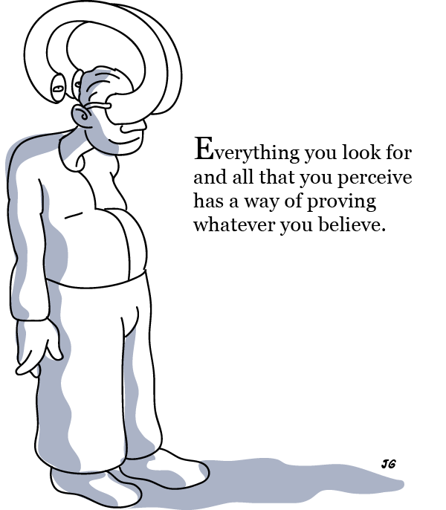
Postmodern Bible study:

Slide 18
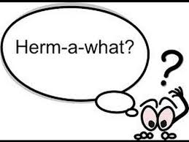
How to use: Hermeneutic

Slide 19
Top 3 rules of Hermeneutics:
Context
Context
Context !

Slide 20
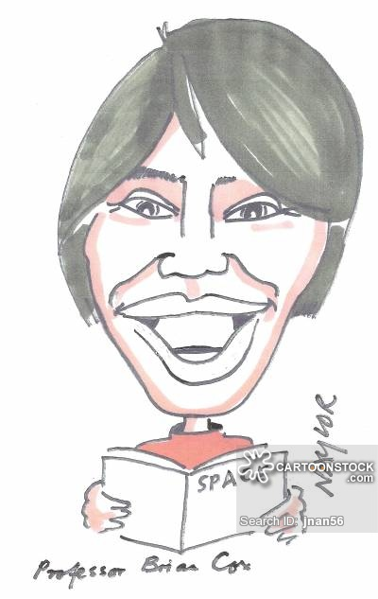
Example 1:
Genesis 1: 1 & 2
1 In the beginning God created the heavens and the earth.
² Now the earth was without shape and empty, and darkness was over the surface of the watery deep, but the Spirit of God was moving over the surface of the water. ³ God said, “Let there be light.”
Add up the genealogies = ~6000 years
But the earth is 4.5 billion years old!

Slide 21
Example 1:
Genesis 1: 1 & 2
1 In the beginning God created the heavens and the earth.
² Now the earth was without shape and empty, and darkness was over the surface of the watery deep, but the Spirit of God was moving over the surface of the water. ³ God said, “Let there be light.”
INSERT 4.5 BILLION YEARS HERE!

Slide 22
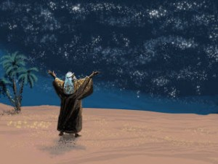
Example 2:
Genesis 1: 1
1 In the beginning God created the heavens and the earth.

Slide 23
We are Separate Because?
We believe the Bible is God’s inspired ‘word’
We believe it is useful for
Teaching
Reproof / correction (correcting behaviour)
Training in righteousness
We believe in a ‘symphonic view’ of inspiration
We should approach Bible study in a structured way
Avoiding egocentric interpretation
Using accepted Hermeneutic methods!

